Slide 1

Department of Artificial Intelligence & Data Science Academic year: 2023-24 Mini Project– Review Presentation
Employee Attrition Prediction
Name : RAHUL BABU B U
USN: 1DB21AD038
GUIDE: Mrs . Subhashini B N
Designation: Assistant Professor
Department of AI&DS
DBIT, Bengaluru

Slide 2


Introduction
Employee attrition is a critical issue facing organizations today. Accurately predicting employee turnover can help companies retain top talent and improve workforce planning. This presentation will explore the problem of employee attrition and discuss a machine learning approach to address it.

Slide 3
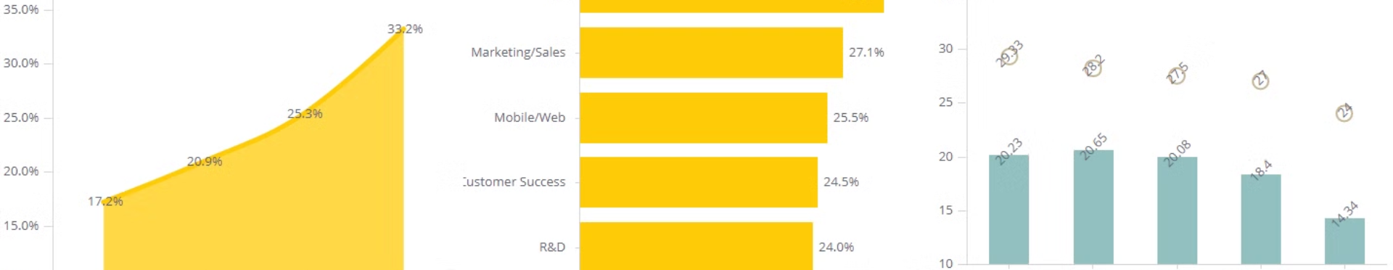
Problem Statement
1
High Turnover Costs
2
Unpredictable Attrition
3
Retention Challenges
Employee turnover is costly for businesses, with expenses related to hiring, training, and lost productivity.
It's often difficult to anticipate which employees are at risk of leaving the organization.
Identifying key factors driving attrition is crucial to developing effective employee retention strategies.

Slide 4

Aim and Objective
Predict Attrition Risk
Identify Influencing Factors
Improve Retention Strategies
Develop a machine learning model to accurately predict the likelihood of employee turnover.
Analyze key features that contribute to employee attrition, such as job satisfaction, compensation, and work-life balance.
Provide insights to help organizations implement targeted interventions to reduce employee turnover.

Slide 5
System Design
Data Collection
Data Preprocessing
Model Development
Gather relevant employee data, including demographic information, performance metrics, and employee feedback.
Clean and preprocess the data, handling missing values, encoding categorical features, and scaling numerical features.
Train and optimize machine learning models, such as logistic regression or decision trees, to predict employee attrition risk.

Slide 6

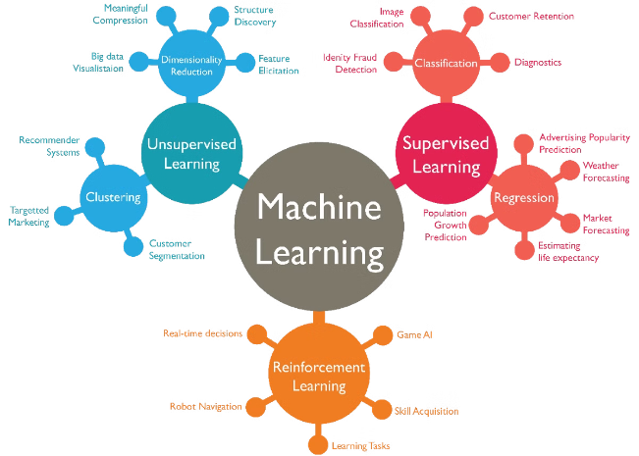
Methodologies
1
Data Exploration
Perform exploratory data analysis to understand the dataset and identify potential predictors of employee attrition.
2
Feature Engineering
Create new features from the existing data to improve the model's predictive power, such as tenure, promotion history, and job satisfaction scores.
3
Model Selection
Evaluate and compare the performance of various machine learning algorithms, including logistic regression, decision trees, and random forests.

Slide 7




Application of the Project
Targeted Interventions
Workforce Planning
HR Decision Making
Use the model's predictions to identify high-risk employees and implement personalized retention strategies.
Incorporate the model's insights into workforce planning to anticipate and address potential attrition issues.
Provide HR managers with data-driven insights to make more informed decisions about employee management and development.

Slide 8





Future Scope of the Project
Expand Data Sources
Integrate additional data sources, such as employee survey results and external market factors, to enhance the model's predictive capabilities.
Incorporate AI
Explore the use of advanced AI techniques, like deep learning, to further improve the accuracy of employee attrition predictions.
Real-time Monitoring
Develop a real-time monitoring system to continuously track and update employee attrition risk, enabling proactive interventions.

Slide 9


References
Griffeth, R. W., Hom, P. W., & Gaertner, S. (2000). A meta-analysis of antecedents and correlates of employee turnover: Update, moderator tests, and research implications for the next millennium.
Hausknecht, J. P., & Trevor, C. O. (2011). Collective turnover at the group, unit, and organizational levels: Evidence, issues, and implications.
Mburu, L. W. (2017). Factors influencing employee turnover in the hotel industry in Kenya.

Slide 10

Conclusion
1
Predictive Insights
2
Improved Retention
3
Informed Decision Making
The employee attrition prediction model can provide valuable insights to help organizations proactively address turnover challenges.
By identifying high-risk employees and implementing targeted interventions, companies can improve employee retention and reduce associated costs.
The project's findings can support HR managers in making more informed decisions about employee management and development.

Slide 11
Algorithm Architecture
Data Preprocessing
Feature Engineering
Model Training
Clean and preprocess the employee data, handling missing values, encoding categorical features, and scaling numerical features.
Create new features from the existing data to enhance the model's predictive power, such as tenure, promotion history, and job satisfaction scores.
Train and optimize machine learning models, such as logistic regression or decision trees, to predict the likelihood of employee attrition.

